Slide 1
Stock Prediction Program Instruction
Kim Seojin, Kim woohyuk

Slide 2
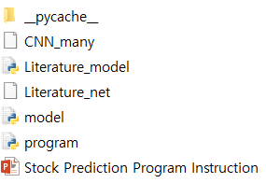
Files
Trained parameters (to be loaded in program.py)
CNN_many (CNN model)
Literature_net (CNN, LSTM combined model)
Models
Model.py (CNN model)
Literature_model.py (CNN, LSTM combined model)
Program.py
Only need to execute this file
Default is CNN model

Slide 3
Prerequisite
My environment
Python 3.7.4
Modules needed
Pytorch
pip install pytorch
PyQt5
pip install pyqt5
Pandas-datareader
pip install pandas-datareader
Sklearn
pip install sklearn

Slide 4
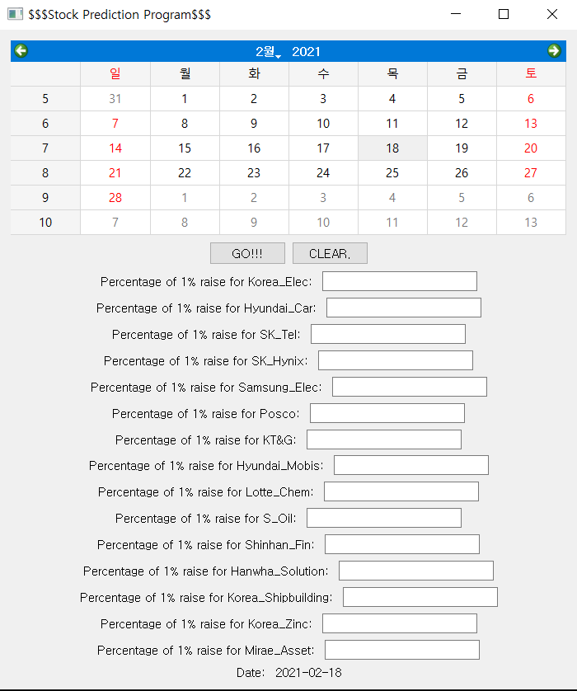
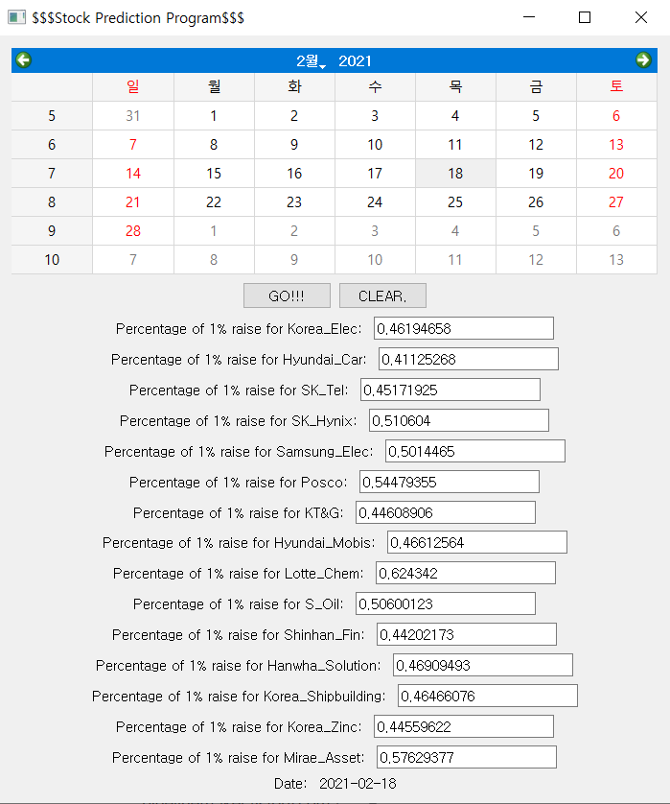
How to run?
“Python program.py”
Default is CNN version
If you want CNN+LSTM combined version, use “python program.py Combined”
Then, UI shows up.
Click “GO!!”

Slide 5
Thank you

